Slide 1
E-Governance Unit 2 E-governance models

Slide 2
E-governance model
e-governance is defined fundamentally as applications of ICT to governance activity.
this can be manifested in multifarious ways and models
Models for e-governance, especially in the developing countries, are essential for a right perspective on e-governance implementation
Models of digital governance are still evolving in developing countries. A few generic models have been shaped up, which are finding greater recognition and are being replicated
These models are based on the inherent characteristics of ICT
such as enabling equal access to information to anyone who is a part of the digital network

Slide 3
E-governance model
de-concentration of information across the entire digital network, connecting all sources of information
( information does not reside at any one particular node in the Digital Governance Models but flows equally across all the nodes)
Hierarchy is inherent in the government departments.
Equity based information flow may not be always compatible with government functioning.
so, appropriate administrative reforms and some reengineering may be required before e-governance may be really implemented.
models of governance are fundamentally different from developed countries due to differences in the basic conditions, perspectives and expectations from good governance.

Slide 4
E-governance model in Developing country
These are generic model of E-governance in Developing country
Broadcasting/Wider Dissemination Model
Critical Flow Model
Comparative Analysis Model
Mobilization and Lobbying Model
Interactive Service Model
E-Governance Maturity Model
These models exhibits several variations dependent on the local situation and the governance functions carried out through these models.

Slide 5
E-governance model in Developing country
Broadcasting/Wider Dissemination Model
Critical Flow Model
Comparative Analysis Model
Mobilization and Lobbying Model
Interactive Service Model
E-Governance Maturity Model
Various features of all e-governance models include the following;
Standard health services and information
Legislation and executions of laws
Access to government officials and their offices
Address on shared environmental challenges through the digital platform
Warnings to the citizens in case of any predictable disaster such as earthquakes and floods

Slide 6
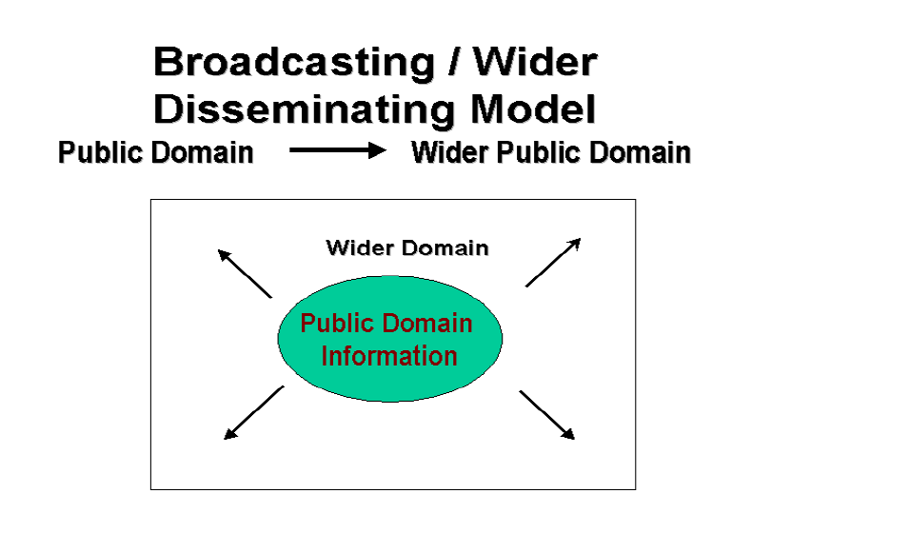
Broadcasting/Wider Dissemination Model
Principle-
model of e-governance is based on the distribution of information which is essential for better governance.
The work of the model is to reach a wider public domain through the use of ICT since this information is already in the public sphere.
An informed citizen understands governance mechanism quickly and is in a position to make sober choices in exercising his responsibilities and rights
unlocks up an alternative channel for people to gain access to data and distribute it to the local /public domain from outside sources

Slide 7
Broadcasting/Wider Dissemination Model
Principle-
there is a greater likelihood that the society in which the individuals are equally informed will ensure that the agenda and forms of governance are not biased to favor few
The widespread application of this model gradually corrects the situation of information failure and provides people with the basic government-related information to come to a common understanding and decide upon the future course of action

Slide 8
Broadcasting/Wider Dissemination Model
Principle-

Slide 9
Broadcasting/Wider Dissemination Model
Applications of Wider Dissemination Model :
Putting into the public domain, the names, contacts and address of government officials
Posting government legislations and laws into online platforms for easier access
Making significant judicial statements/ judgments that are vital to citizens online
Availing information about plans of the government such as budgets, security conditions, and expenditures online

Slide 10
Broadcasting/Wider Dissemination Model
Evaluation of Wider Dissemination Model :
Pros:
If national governments aggressively adopt this model, they will effectively create an environment that enhances participation of its people in domestic matters.
This model is the very first move in achieving e-governance platforms since it facilitates free flow and access to information to all parts of the society hence can be referred as the building block of digital governance

Slide 11
Broadcasting/Wider Dissemination Model
Evaluation of Wider Dissemination Model :
Cons:
This model is not useful when the government controls the information being put in the public domain.
Also, the model is pointless when free flow of important content is not encouraged.
It is the sole responsibility of civil societies and government organizations to ensure that this model becomes successful.

Slide 12
Broadcasting/Wider Dissemination Model
Evaluation of Wider Dissemination Model :
Cons:
This model is not useful when the government controls the information being put in the public domain.
Also, the model is pointless when free flow of important content is not encouraged.
It is the sole responsibility of civil societies and government organizations to ensure that this model becomes successful.

Slide 13
Broadcasting/Wider Dissemination Model
Successful projects based on the wider model of e-governance :
Brazil:-
The official National E-government website provides comprehensive information about the government as well as integrates citizens to the E-government
South Africa:-
a network called the Chapter 2 Network which is a center to clear communication and information for social justice. This network distributes information about research and political intelligence, support campaigns and legislation scrutiny to civil society organizations involved in social justice

Slide 14
Broadcasting/Wider Dissemination Model
Successful projects based on the wider model of e-governance :
Earth Negotiations Bulletin
The Earth Negotiations Bulletin (ENB) is a balanced, timely and independent reporting service on United Nations environment and development negotiations
is a network service that keeps citizens around the globe aware of international environmental negotiations, decisions, and processes.
It’s of primary value to governments and the people especially in the developing countries so as to record international decisions and take the necessary precautions .

Slide 15
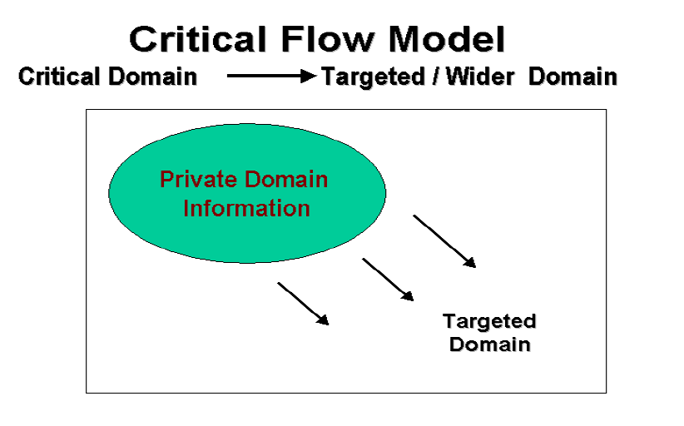
Critical flow Model
This model has been able to address and access critical nformation such as:
Violations of human rights
Security threats
Information on corruption both in the public and private sectors
The green ratings of a company

Slide 16
Critical flow Model
Principle of Operation:-
is based on distributing key value data to the targeted people or by disseminating it to the broad public using any available convergent media or through ICT
Targeted audience includes media, affected parties, oppositon parties, judicial bench,whisteblower, private investigator or general public.
requires the users to understand the importance of any data set and how to use it strategically
it may involve establishing the position of users to whom the accessibility of particular data can make a significant difference in implementing good governance

Slide 17
Critical flow Model
Principle of Operation:-
(The strength of this model is that the concept of 'distance' and 'time' becomes redundant when information is hosted on a digital network. Once available on the digital network, the information could be used advantageously- by instantly transferring the critical information to its user group located anywhere or by making it freely available in the wider public domain.)
This concept lowers cases of exploiting governments which are possible as due to the time lag between availability of data between various users

Slide 18
Critical flow Model
Applications of critical flow e-governance :-
Making available corruption related data about a particular Ministry / Division/ Officials online to its electoral constituency or to the concerned regulatory body.
Making available Research studies, Enquiry reports, Impact studies commissioned by the Government or Independent commissions to the affected parties.
Making Human Rights Violations cases violations freely available to Judiciary, NGOs and concerned citizens.
Making available information that is usually suppressed, for instance, Environmental Information on radioactivity spills, effluents discharge, information on green ratings of the company to concerned community.

Slide 19
Critical flow Model
Example:-
Global: Wikileaks www.wikileaks.org
WikiLeaks is a not-for-profit media organisation. It brings important news and information to the public.
It publishes secret information, news leaks and classified media from anonymous sources to keep the public informed, amongst others on cases of corruption, whistleblowing, and crimes.
Global: Transparency International -Daily Corruption News
http://www.transparency.org/feed/dcn
A service is being run by Transparency International called the "The Daily Corruption News" which reports on corruption from around the world. The daily corruption news has been coming out since May 2000.

Slide 20
Critical flow Model
Example:-
India: Central Vigilance Committee
http://cvc.nic.in
The website provides free-access information to citizens about government officials who have been indicted on judicial charges relating to corruption and have been advised penalty.
People can also file complaints against any public servant who fall within the jurisdiction of the Commission.

Slide 21
Critical flow Model
Example:-
India: Project VIGEYE
http://www.vigeye.com/
Vigeye (Vigilance Eye) is a citizen-centric initiative, wherein citizens join hands with the Central Vigilance Commission in fighting corruption in India.
Project Vigeye is the platform through which vigilance information flows freely through common public, the government agencies and the vigilance commission, making it possible to achieve a step jump in improving the corruption index of the nation

Slide 22
Critical flow Model
Evaluation of critical flow model
Pros :-
Critical model is based mostly on the direction of its information and its prospective users By concentrating on the important aspect of data, the weakest feature of governance and its decision-making body.
This model informs people about particular instances of political failure and improper governance.
While fuelling public strife, this system puts pressure on the responsible government officials and bodies to take into consideration the concerns and the opinions of citizens while making decisions

Slide 23
Critical flow Model
Evaluation of critical flow model
Cons :-
The government itself may have a limited motivation, and attitudes in sharing such important information.
The only way to achieve such a model is to lay its implementation responsibility to civil societies so as to have efficient watch on government actions and policies
The model may not work properly on instances where the government bodies do not encourage public contributions and criticize all information of critical nature
Finally, the model will also fail where the government maintains tight control over all information and remains available to only a few top levels of the government.

Slide 24
Comparitive Analysis Model
Principle:-
Comparative Analysis Model is one of the least-used but a high potential e-governance model for developing countries.
The model can be used to empower people by comparing cases of bad governance with those of good governance and identifying specific aspects of bad governance, the reasons and people behind them, and how the situation can be improved.
The model is based on using immense capacity of ICT and social media tools to explore given information sets with comparable information available in the public or private domain

Slide 25
Comparitive Analysis Model
Principle:-
For instance, if a given amount of money can build 5 primary schools in District 'A' in a country, then why does the same amount of money build only 2 schools in District 'B'? Could this be because of corruption of officials and contractors involved, or siphoning of money for other things?
The outcomes are strategic learnings and empowerment, and can lay the basis for possible action, eg: filing of right to information (RTI) to find where the money went.
the model continuously assimilates “best practices” in different areas of governance and uses them as benchmark to evaluate other governance practices.

Slide 26
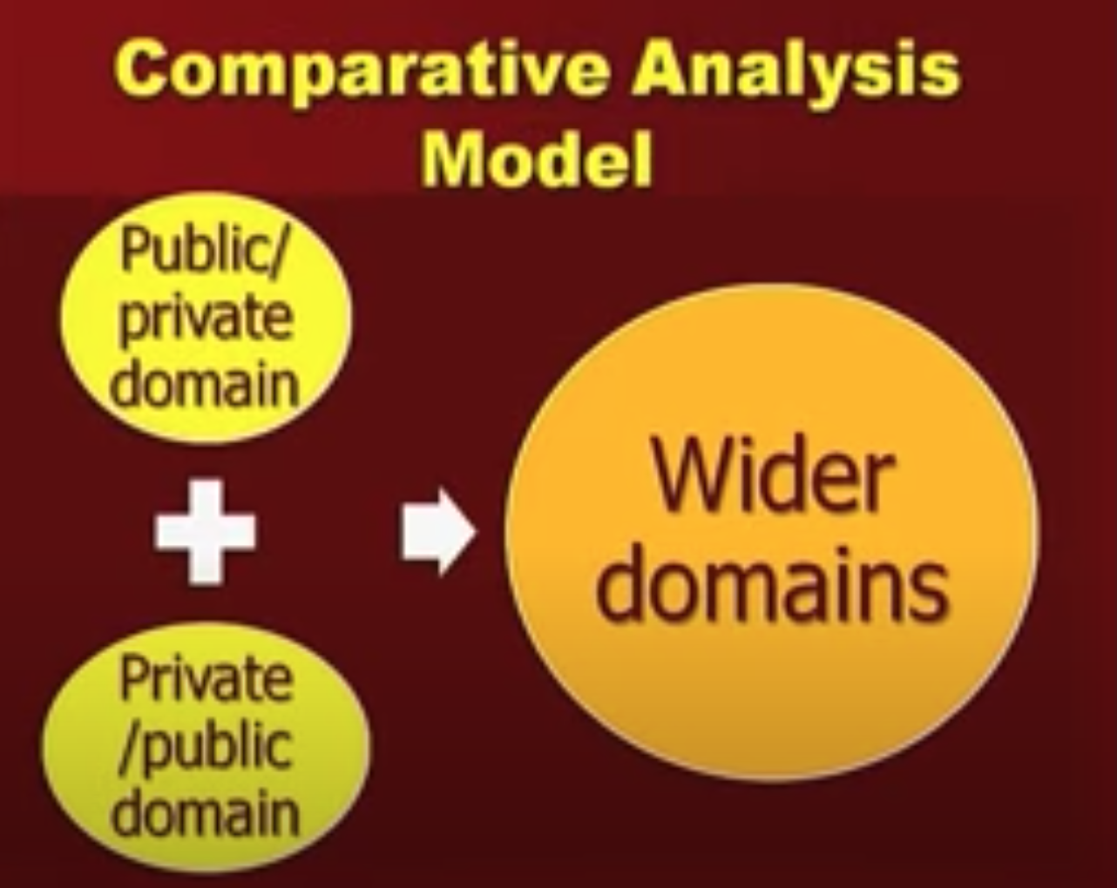
Comparitive Analysis Model
Principle:-
It then uses the result to advocate positive changes or to influence 'public' opinion on existing governance practices.
The comparison could be made over a time scale to get a snapshot of the past and the present situation or could be used to compare the effectiveness of an intervention by comparing two similar situations.
The strength of this model lies in the infinite capacity of digital networks to store varied information and retrieve and transmit it instantly across all geographical and hierarchical barriers

Slide 27
Comparitive Analysis Model
Applications:-
Model establishes the conditions of prior preference, particularly in the case of legal or judicial decision-making, and uses it to manipulate how decisions are made in the future. (example for resolving patent-related disputes, public goods ,ownership, rights), and use it to influence/advocate future decision-making.
Used in assessing the performance of a particular public servant, ministry or the government.
Enables making informed decisions at all government levels by empowering the background to know how and provide a justification for the future course of action

Slide 28
Comparitive Analysis Model
Applications:-
To learn from past policies and actions and derive learning lessons for future policy-making.
To evaluate the effectiveness of the current policies and identify key learnings in terms of strengths and flaws in the policies.
Evaluation of the model :-
Pros:
Developing countries could very effectively use this comparative model as ICT opens their access to the global and local knowledge products at a relatively low -cost.
Organizations trusted in maintaining this digital platform may use it to track the performance of electoral candidates and share the records in their constituencies.

Slide 29
Comparitive Analysis Model
Evaluation of the model :-
Pros:
Developing countries could very effectively use this comparative model as ICT opens their access to the global and local knowledge products at a relatively low -cost.
Organizations trusted in maintaining this digital platform may use it to track the performance of electoral candidates and share the records in their constituencies.
There is a vast scope of application of this model for judicial advocacy as landmark/key judgments of the past could be used as precedence for influencing future decision- making.

Slide 30
Comparitive Analysis Model
Evaluation of the model :-
Pros:
Further, watch-guard organizations and monitor-groups can use this model to continuously track the governance past record and performance and compare with different information sets.
Cons:-
The model however becomes ineffective in absence of a strong civil society interest and public memory which is essential to force decision-makers to improve existing governance practices
the model relies on the availability of other information’s for comparison and the attitude of people to examine and come up with self-explanatory or strong arguments from the analysis.

Slide 31
Comparitive Analysis Model
Example of the model :-
Global: Human Development Indicators
http://hdr.undp.org/en/statistics/
The Human Development Report of UNDP makes use of archived Statistical information pertaining to literacy, health, national income etc. as a benchmark to assess the progress made by different countries with regards to their Human Development Index and suggests policy recommendations based on that.
Many countries now also prepare national level indicators to compare progress made in different states in a country.

Slide 32
Comparitive Analysis Model
Example of the model :-
India: Comparative Learning from Disasters
http://www.cddc.vt.edu/digitalgov/Latur-Gujarat.htm
In the wake of earthquake in Kutch in India (January 2001), there was a lot of comparative learning relating to disaster management drawn from a high intensity earthquake which shook Latur in India in 1993. The extensive information available on internet on both these earthquakes open up vast scope of comparison by all segments of the society.
A presentation by Mr. Praveen Singh Pardesi- Indian Administrative Service (IAS) officer of the Maharashtra cadre and currently Joint Secretary to the Chief Minister of Maharashtra, India)

Slide 33
Comparative Analysis Model
Example of the model :-
India: Comparative Learning from Disasters
Comparison of different Disasters can make people realise that damages to life and property incurred are not just a factor of intensity of the disaster but also dependent on the preparedness of the Government machinery and conducive government policies to handle that disaster.

Slide 34
E-Advocacy Model
Also called as Mobilisation and lobbying model
Underlying principle:-
one of the most frequently used Digital Governance model and has often come to the aid of the global civil society to impact on global decision-making processes.
Mobilization model is based on strategic, the directed flow of information to strengthen action and build strong allies
It takes up a proactive approach of building virtual communities which promote vigorous sharing of information and sharing of similar values
The diversity of these virtual communities is the strength of this model and the resources, and ideas brought together through virtual methods of network

Slide 35
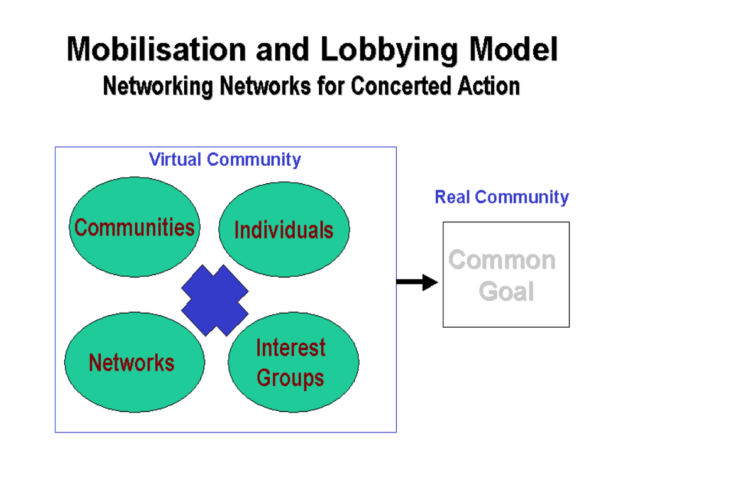
E-Advocacy Model
n
The model is able to mobilize and leverage human resources and information beyond geographical, institutional and bureaucratic barriers, and use it for concerted action.

Slide 36
E-Advocacy Model
Applications:-
Formation of groups that compel decision-making organizations to recognize their concerns
Advocating for the rights of the marginalized groups from the decision-making organs
Compelling for public debates on global issues and themes of any imminent conferences
Advocating for wider involvement in decision-making processes
Building up global expertise on a particular theme in absence of localised information to aid decision-making.

Slide 37
E-Advocacy Model
Examples:
Global: Drop the Debt Campaign -
the campaign spreads awareness of their activities through emails and mobilises support of concerned individuals, and encourages them to directly express their concern to key decision-makers (by making available their email and other contact addresses).
http://www.jubileeusa.org/
India:PRS Legislative Research
Tracks parliamentary bills which have been introduced and are coming up for discussions. It analyses the bills, prepares summaries of reports of standing committees, puts forward its position, and engages in processes which allow them to voice their opinions.
http://www.prsindia.org/billtrack/

Slide 38
E-Advocacy Model
Evaluation (pros and cons)/Discussion:
This model gained ground after the onset of the Seattle round of WTO which led to the formation various virtual communities that advocate the concerns of the developing nations in the WTO agreement. This was as a result of massive discussions that must have taken place over virtual networks before the summit.
The model increases the range of membership of individuals and communities in debates and any policy issues.
The model creates a limit for members to be careful or get the opinion of the global members is against them
This model can also be used to gauge public opinions by the government, especially on particular issues.

Slide 39
Interactive Service Model
Principle:
Also known as G2C2G model
Interactive-Service model is a consolidation of the other digital governance models and opens up possibilites for one-to-one and self-serviced participation of individuals in governance processes.
ICTs have the potential to bring every individual into a digital network and enable interactive (two-ways or multiple-ways) flow of information among them.
G2C2G entirely includes the potential of ICT and use it for greater transparency and efficiency, and participation in government functions as well as saving time and cost related to the decision-making process.

Slide 40
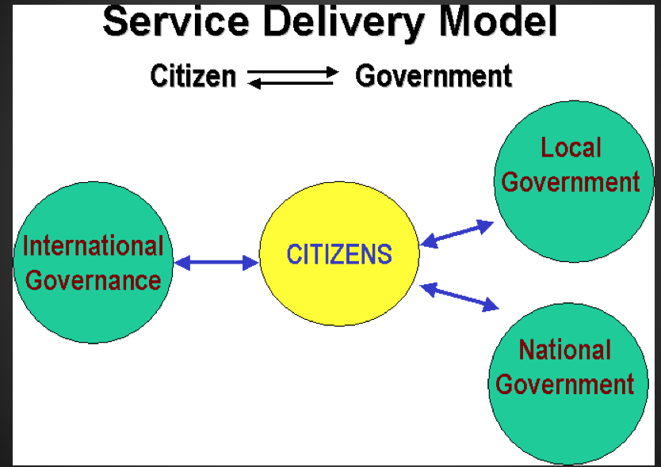
Interactive Service Model
Principle:
the various services offered by the Government become directly available to its citizens in an interactive manner
It does so by opening up an interactive
Government to Consumer to Government (G2C2G) channel in various aspects of governance, such as election of government officials (e-ballots); decision to make on specific issues (eg: health plans), delivery of individualised government services, gauging public mood and opinions

Slide 41
Interactive Service Model
Applications:
to establish an interactive communication channels with key policy-makers and members of planning commissions.
Used in conducting electronic ballots during election of government officials
Filling of reports and grievances to various government bodies by the citizens
Performing governance functions online such as revenue collection, filing of taxes, governmental procurement, payment transfer etc
Used in carrying out opinion polls or public debates on issues affecting the everyday citizens

Slide 42
Interactive Service Model
Evaluation(Pros and cons):-
The model firmly relies on the interactive applications of ICT and therefore is a technology and cost - intensive model which will require a transition period before being adopted on a wider scale, especially in the developing countries
require elemental familiarity of ICT among the citizens to fully benefit from this model
Nevertheless, the diminishing costs of ICT and the advantages offered by this technology would certainly catalyse the penetration of this model.
(Intermediary organisations, knowledge networkers and middlemen will play a tremendous role to play in widespread replication of this model.)

Slide 43
Interactive Service Model
Example:-
Philippine Customs Reform : Using an "off-the-shelf" customs application package as the main building block, the Philippines Customs Bureau has developed an on-line system to process clearance of imports, payment of duty, and delivery of release orders for shipments to leave the docks.
The new on-line system has lessened the cost of trade for businesses, reduced opportunities for fraud, and helped the Bureau to maximize revenue collection. http://www1.worldbank.org/publicsector/egov/philippinecustomscs.htm

Slide 44
Interactive Service Model
Example:-
·India: Gyandoot :-
Gyandoot is an intranet in Dhar district connecting rural cybercafes catering to the everyday needs of the masses. The site has following services to offer in addition to the hope that it has generated by networking, the first district in the state of Madhya Pradesh in India
Commodity/ Agricultural Marketing Information System
Copies of land maps
On-Line Registration of Applications
Public Grievance Redressal
http://www.gyandoot.net/gyandoot/intranet.html

Slide 45
THANK YOU!
Any Queries?

